Slide 1
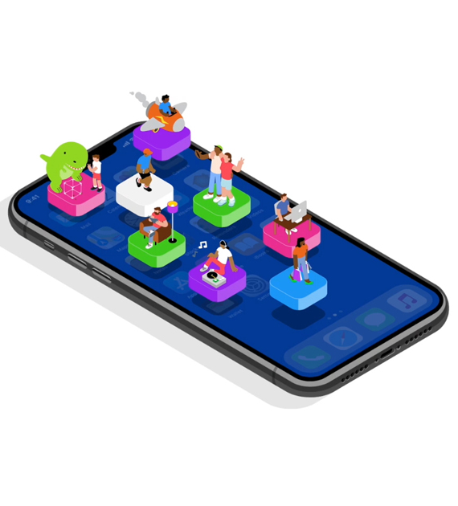

Design and Development of a Health-Care App
Internship at Briota Technologies
Presented By: Sanchit Kripalani
Roll no: 31145
Mentor: Shardul Joshi (Tech lead at Briota)
Internship Guide: Prof. Manish Jansari

Slide 2
Content
Objective and Scope
Introduction
Motivation
Salient features
Methodology
Flow Chart
Technological Analysis
Outcome and Achievements
Conclusion
References

Slide 3
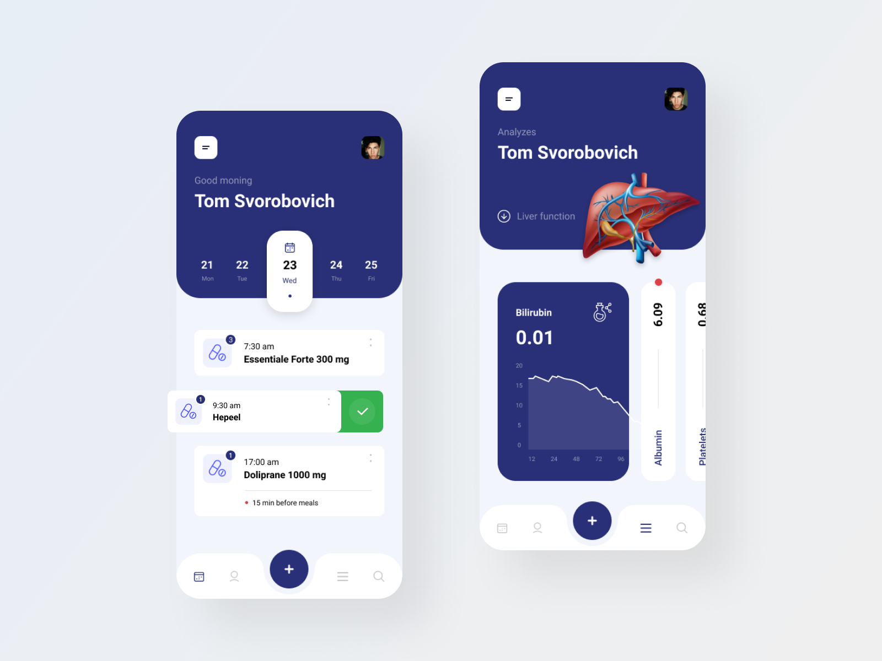
OBJECTIVE
“Design and develop a daily use healthcare app for Asthamatic Patients.”

Slide 4
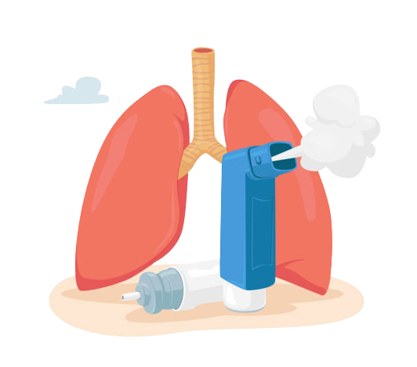
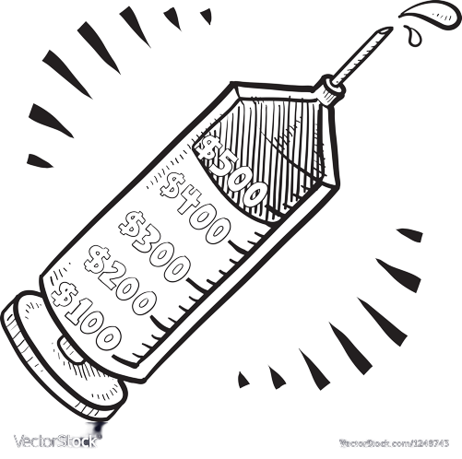
Scope
Nowadays healthcare is extremely expensive, particularly in European and North American Countries. Asthamatic patients, especially elderly ones need constant health monitoring for their well-being.

Slide 5




Introduction
After the onboarding procedure, a mentor (Shardul Joshi Sir) was assigned to lead our project.
The project required us to make an App for both IOS and Android devices.
The App was designed and developed with Flutter as the framework.
The Internship with Briota lasted for 3 months (Oct-Dec).

Slide 6
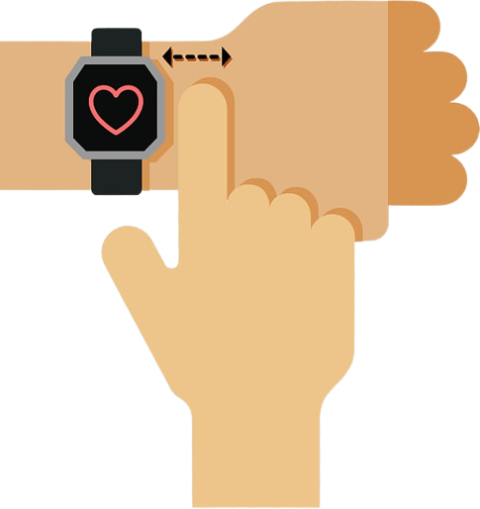
Motivation!
With the rise in the number of heart and respiratory disease cases, it is becoming more and more important to monitor health on a daily basis.
Modern Technology has made it really easy to monitor personal health, using Apps which interact with the user on a daily basis.
Finally, Apps make it easy to track health everyday, which helps decrease healthcare expenditure. Since the European market has experienced a sharp increase in healthcare charges, Apps can provide a cost-effective solution to daily health tracking.

Slide 7

Salient Features
For Users (Patients):
Register to a paid subscription based plan.
Access to daily diary to feed their health status everyday.
Help set-up regular checkups with local doctors.
Provide statistics like Spo2, calories burnt.
Provide a diet plan suggested by expert dieticians.
For Doctors:
Monitor the status of their patients and schedule appointments with them.

Slide 8
Methodology and Functional Components
The App has these basic screens:
Registration and authentication of users. A Paywall needed to subscribe to a healthcare plan.
Home screen showing daily health statistics and reports.
Daily Diary to store regular health status.
Profile screen to view personal details and subscription plans.
Contact screen to communicate with medical professionals.

Slide 9
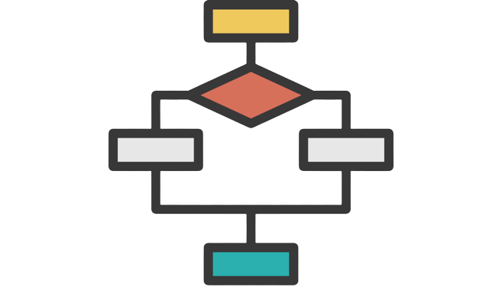
Diagrammatic Flow

Slide 10
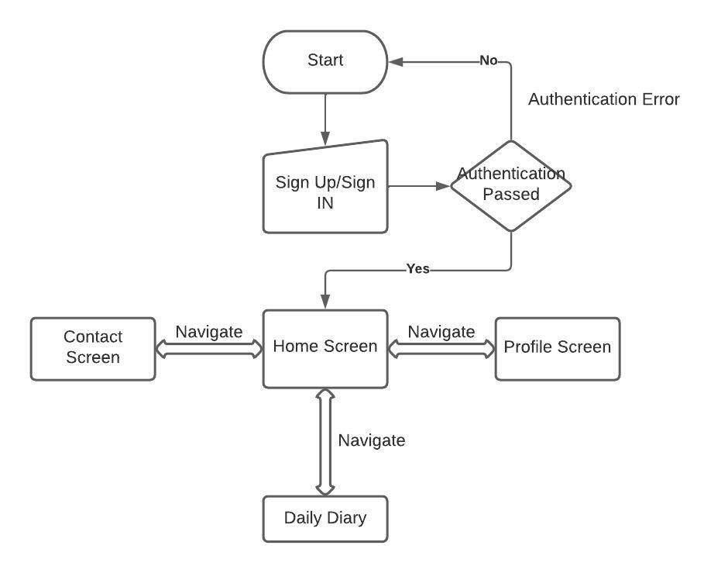
App Flow Chart
Fig 1. App Navigation

Slide 11


Technological Analysis
The following are the important technological frameworks used in the App:
Flutter: It is a cross-platform framework which can create Apps which can run on both IOS and Android. The choice of using flutter depends on the target devices. Since an App made in flutter can run on both IOS and Android, without having to code separately for the different operating systems.
Firebase: This is a cross-platform SDK which can be used for a variety of back-end tasks like database storage, authentication. Useful because it is easy to use and implement.

Slide 12

Outcomes And Achievements
The following was achieved through the course of the Internship:
Learning the Flutter framework, which enabled the team to create an App for both IOS and Android, by writing a single piece of code.
Design and implement the basic UI for the app including Sign in/Sign Up, Profile page etc.
Connect App UI to the back-end services of Firebase for authentication, user information storage etc.

Slide 13
Conclusion
Regular mentor meetings ensured the successful completion of the project and the relevant milestones were reached.
New Technologies were explored and used in order to make the App more efficient and easy to implement.
Interns collaborated on the project in a group thereby increasing their team work skills.
The grounds for an App, which could be a potential game changer in the healthcare industry was laid.

Slide 14
References
Flutter Documentation: https://docs.flutter.dev/
Firebase Documentation: https://firebase.google.com/docs
Tutorials for learning Flutter:
Basic: https://www.youtube.com/playlist?list=PL4cUxeGkcC9jLYyp2Aoh6hcWuxFDX6PBJ
Firebase: https://www.youtube.com/playlist?list=PL4cUxeGkcC9j--TKIdkb3ISfRbJeJYQwC
Stackoverflow: https://stackoverflow.com/questions/tagged/flutter

Slide 15
Thank You!!!

